Slide 1


BECOME AN LLM & AGENTIC AI ENGINEER BOOTCAMP

Slide 2



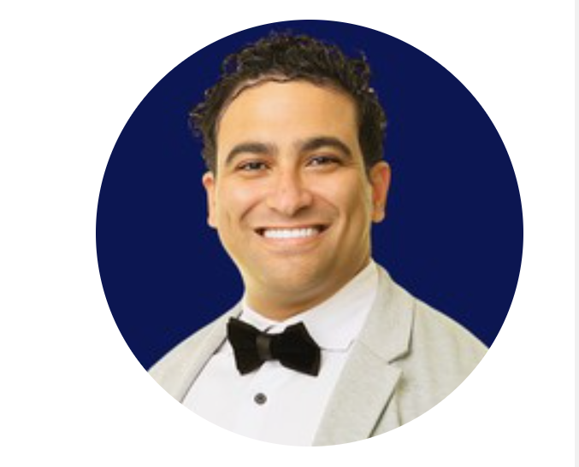





Instructor Introduction
500,000+ Students
M.A.Sc., Ph.D., MBA
250,000+ Subs, 3M views
Dr. Ryan Ahmed Professor & Best-selling Instructor
© All rights reserved for Dr. Ryan Ahmed @Stemplicity Inc.
AI & EV/AV
Taught L1 & 2 Python & AI

Slide 3
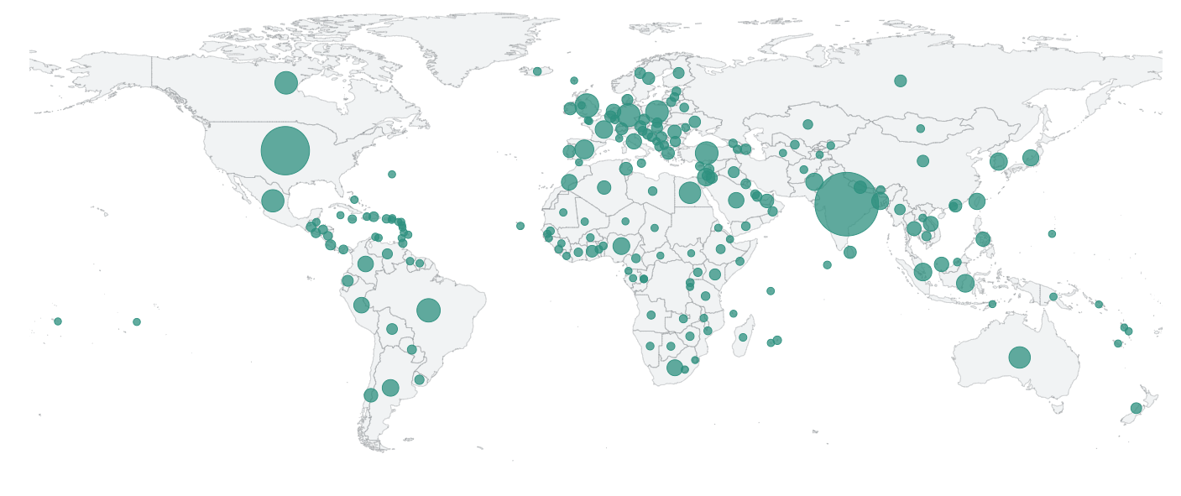










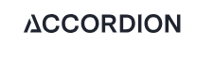
Global Students Reach
© All rights reserved for Dr. Ryan Ahmed @Stemplicity Inc.

Slide 4
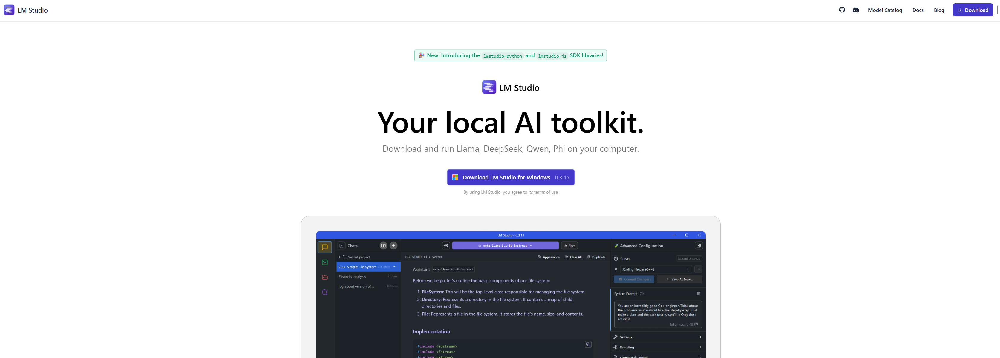
LM STUDIO DEMO!
https://lmstudio.ai/
© All rights reserved for Dr. Ryan Ahmed @Stemplicity Inc.

Slide 5
BOOTCAMP OUTLINE & KEY SUCCESS TIPS

Slide 6
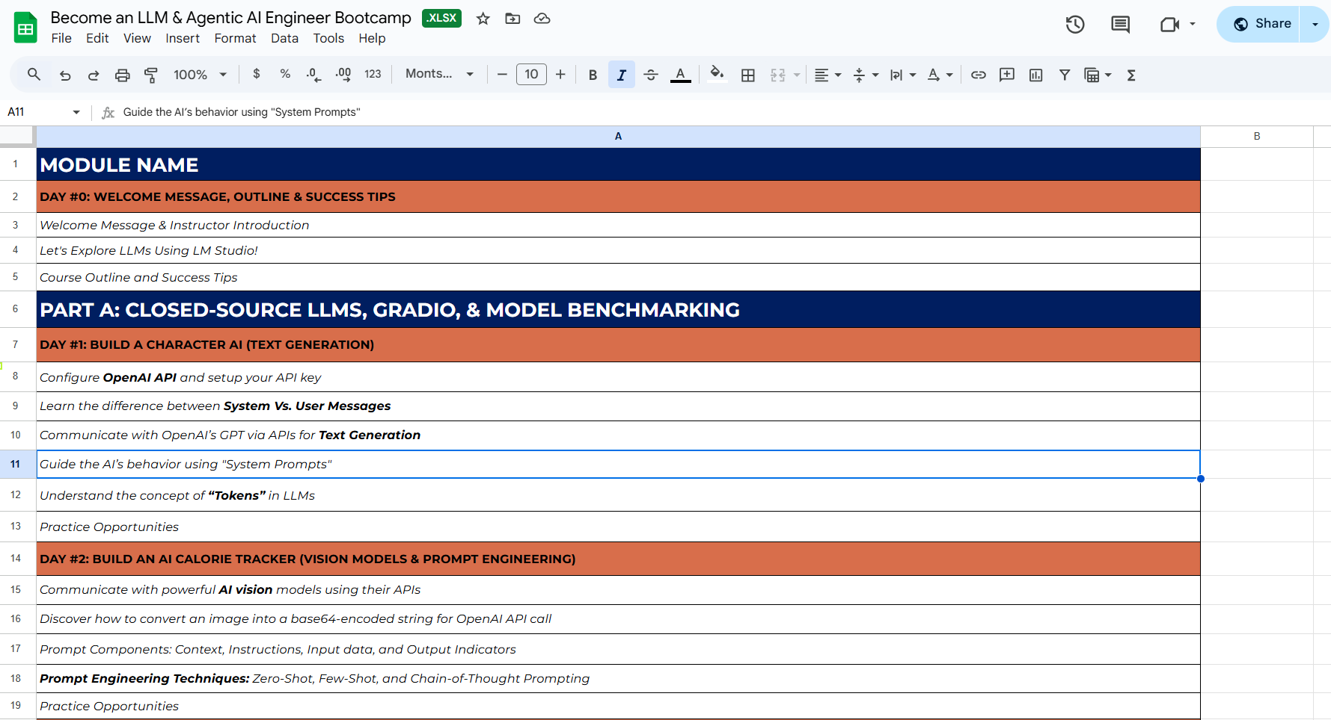
Bootcamp Outline
Check the course outline here:
© All rights reserved for Dr. Ryan Ahmed @Stemplicity Inc.

Slide 7
Success Tips
Learn by Doing!
Ask Questions in the Q&A
Solve Practice Opportunities
Complete All Bootcamp Modules
© All rights reserved for Dr. Ryan Ahmed @Stemplicity Inc.

Slide 8
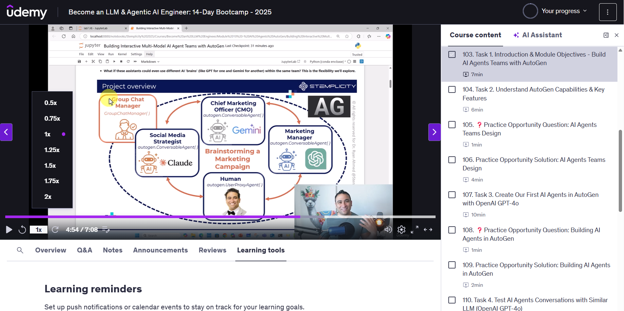
Change video Speeds
You have the option to play lectures at different speeds: (.5x, 1x, 1.25x, 1.5x or 2x)
In the bottom-left corner of the video, you can change the speed of the video.
© All rights reserved for Dr. Ryan Ahmed @Stemplicity Inc.

Slide 9
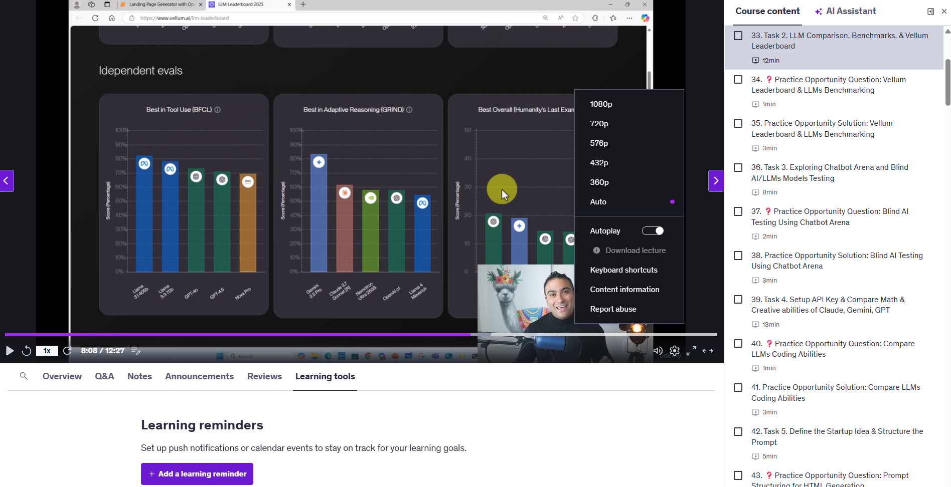
Change the video quality
Udemy automatically optimizes video resolution based on your internet connection speed. Alternatively, you can select 360p, 480p, and 720p resolutions for the video quality.
All course lectures are filmed with HD quality 1080p.
© All rights reserved for Dr. Ryan Ahmed @Stemplicity Inc.

Slide 10
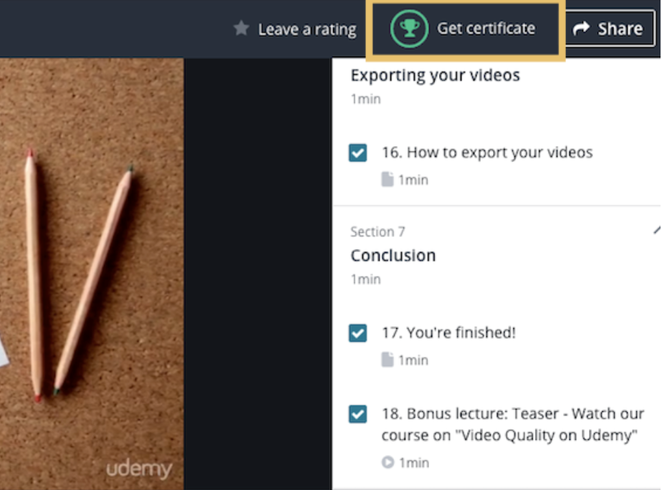
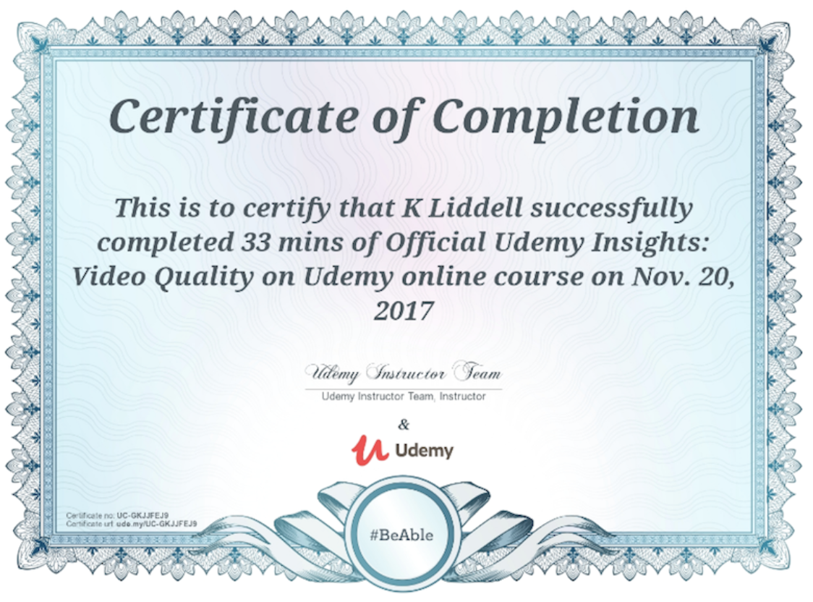
How do you get the Certificate of Completion?
When you complete all course modules, you will receive a certificate of completion.
© All rights reserved for Dr. Ryan Ahmed @Stemplicity Inc.

Slide 11
Thank you!

